Slide 1
caCORE SDK
Satish Patel

Slide 2
Session Goals
By the end of this session, you will be able to:
Use the caCORE Software Development Kit (SDK) to generate code for an application or service

Slide 3
Agenda
SDK requirements
Data service basics
What is caCORE SDK
Data service creation with SDK
Running the SDK code generator
Demonstration

Slide 4
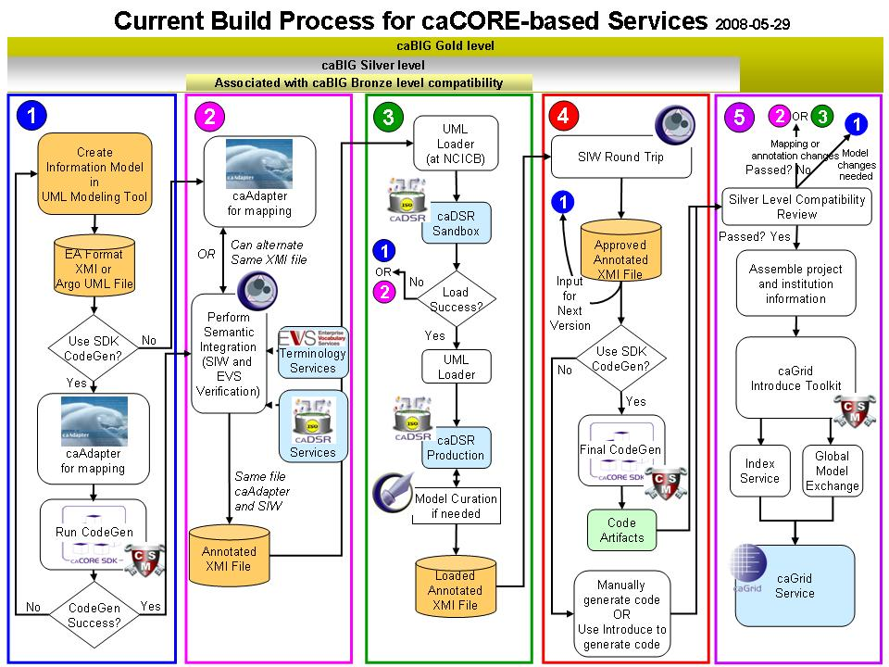
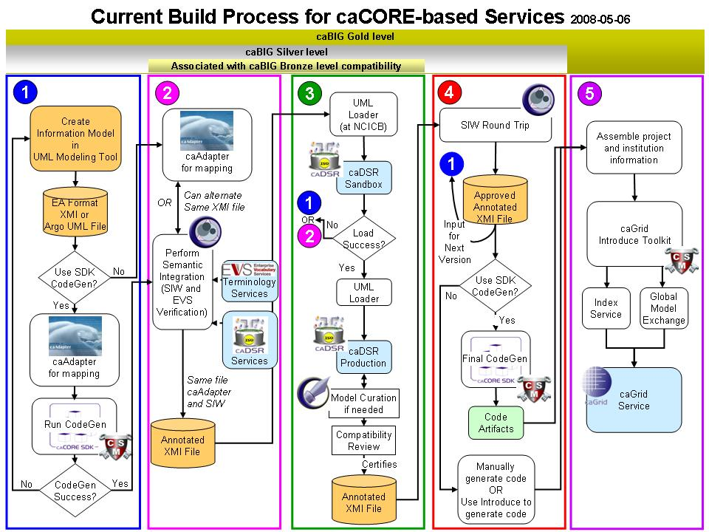
Metadata Reuse
Create UML Model
Semantic Annotation
Transform UML Model into Metadata
SDK Code Generation
Compatibility Review
Create a Node on the Grid

Slide 5
What is Required to Use SDK
Must have working knowledge of
  UML class diagrams
  Enterprise Architect or ArgoUML
  Java
Nice to have knowledge about
  Hibernate
  Web applications
  XML

Slide 6
Required Software
Enterprise Architect (version 6.5+) or ArgoUML
Java Development Kit - JDK (version 1.5 or above)
JBoss (version 4.0.5) or Apache Tomcat (version 5.5.19)
Apache Ant version (version 1.6.5+)
Internet Explorer (version 5.5 or above)
and caCORE SDK Code Generator

Slide 7
Data Sharing Techniques
Distribute it on CD
  Limited reach
  Difficulty in getting updates
Put it on website/FTP
  Download entire data set and install it locally
  Difficult to access subset of data set
Programmatic access
  Easy to update
  Access to data subset of interest
  Difficult to download entire data set

Slide 8

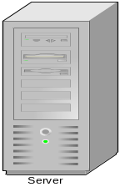
Data Service – What Is It?
A service that allows data owners to share the data from source like relational database (e.g. oracle or mysql) with their collaborators
caCORE SDK Generated System
OR
Custom Built Application
Human readable interface (GUI)
Database
Machine readable interface (Java API / Webservice)

Slide 9
What is caCORE SDK?
Framework to generate a Data Service
  Simple tool to build applications for collaborative research environment
  Enables users to quickly build the APIs from UML Model
  Syntactically interoperable APIs (Query via information model)
Integrated security
Built using open source tools and technologies

Slide 10
Features of the SDK Code Generator
Built on Model Driven Architecture (MDA) principle
  System generation from UML class diagrams
  Users are not required to write any code to generate system
Choice for different UML modeling tools
  Enterprise Architect
  ArgoUML
Support for various O/R mapping configurations
  Simple class/attributes
  Associations with and without join tables
  Inheritance mapping (table per class, table per hierarchy, implicit)

Slide 11
Features of the SDK Generated System
Provides various mechanisms to access data
  Local Java client
  Remote Java client
  Web services
  Web based UI
  RESTful interface
Query By Example (QBE) Interface
  Queries can be formed using information model
  Syntactically interoperable system
Allowing client to access data from multiple remote services

Slide 12
Features of Generated System
Seamless navigation of data source
  Built in pagination of the result set
  Ability to fetch associations on demand in transparent manner
Integration with caGrid tools
  Plug-in available in the caGrid’s Introduce tool to create a grid service from SDK generated system

Slide 13
Security in Generated System
Integrated security provided by Common Security Module
Web based application to configure security policy
Interoperable with the cagrid security implementation
Different level of data access
  Class level security
  Instance level security
  Attribute level security

Slide 14
SDK 4.1 Features
Writable API
  Supports full array of CRUD operations
  Inbuilt validator to validate the data before insert/update
  Support for specifying the primary key generators, cascade settings etc at the UML model level
Integrated logging and auditing with CLM
  Keeps the trail of changes made in the database
  Provides a web based application to view the audit trail
Support for additional ways to perform O/R mapping
  Implicit inheritance
  Abstract classes
  Marker interfaces
Performance enhancements for Query By Example

Slide 15
SDK Roadmap
Freestyle search API
  Ability to specify the search index fields in the UML model
  Provide search engine like functionality on the user’s database
Graphical Installer
  Perform the system generation and deployment from a GUI
  User friendly interface to input the settings in correct fashion
Support for HL7 data types
  Ability to specify HL7 data types in the UML model instead of Java types

Slide 16
caCORE SDK Users
Infrastructure
  caDSR
  EVS
  Object Cart
Genomics
  caArray
  caBIO
  caIntegrator
Tissue Banking
  caTissue
Clinical Trials
  C3PR
  CTODS
  caCTUS
Imaging
  NCIA
Proteomics
  PIR

Slide 17
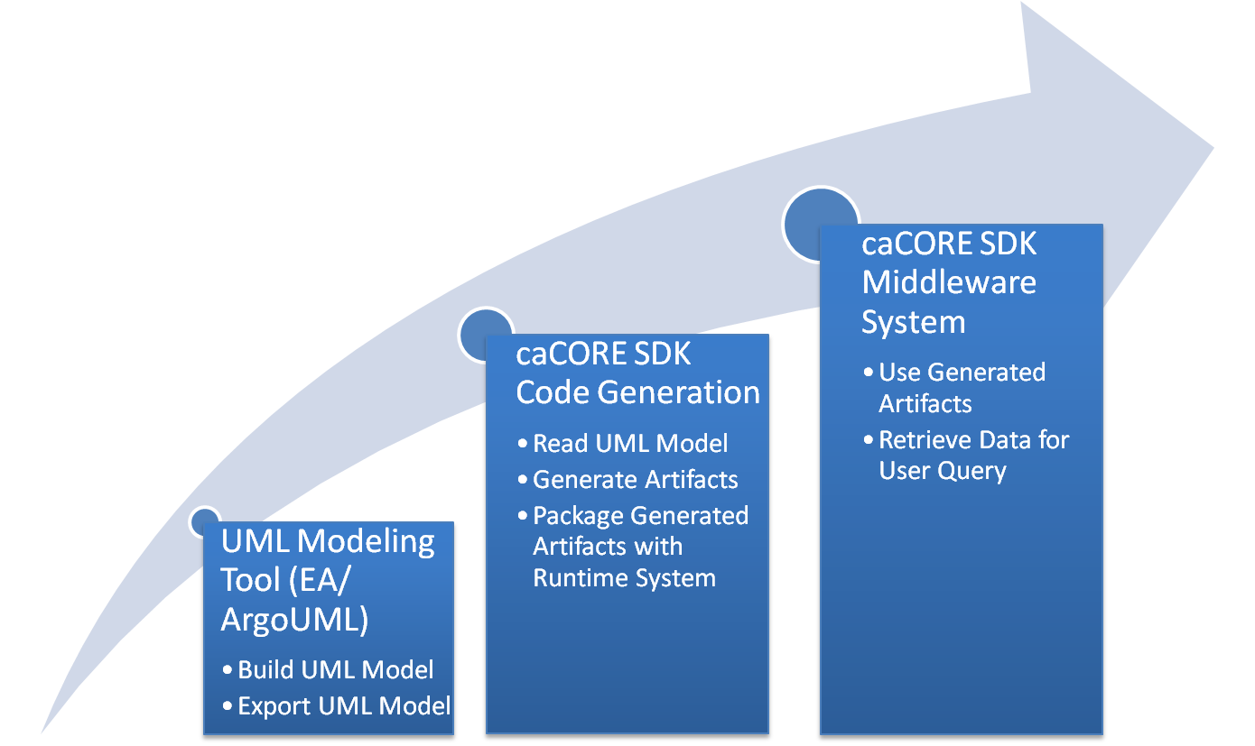
SDK System Generation Process

Slide 18
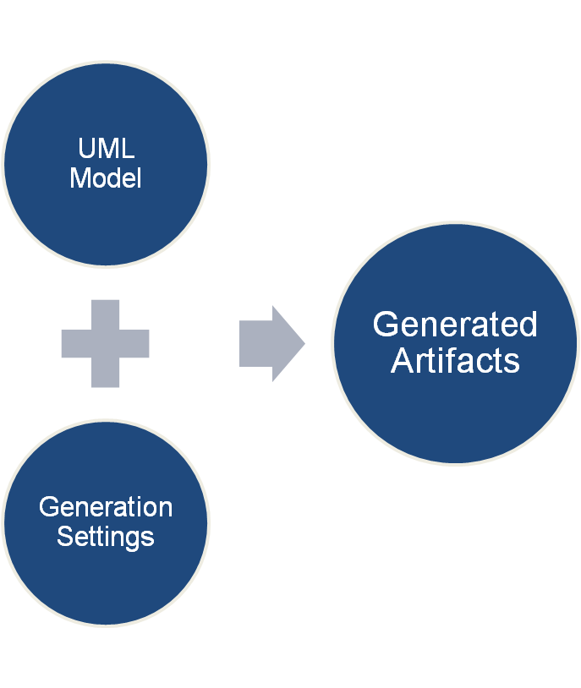
Generated Artifacts from UML
Java beans
Hibernate mapping files
EhCache configuration file
XSD
Castor mapping files
WSDD file
Other configuration files

Slide 19
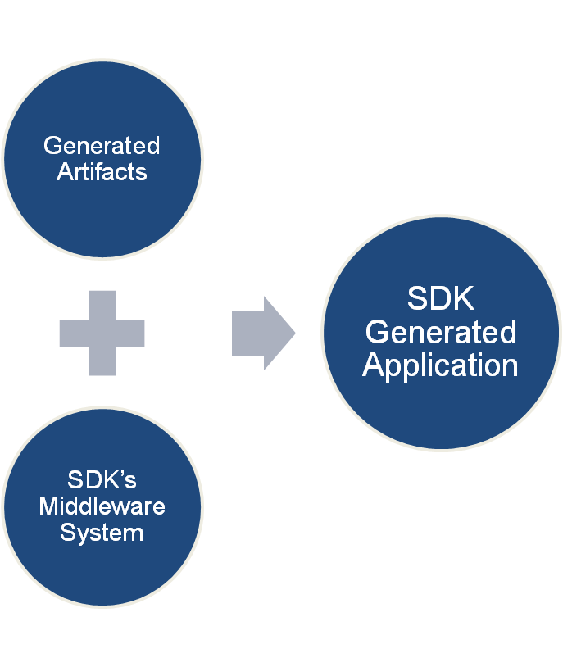
SDK Generated System
Web Application
RESTful Interface
Remote Client
Web Service Interface
Local Client

Slide 20










Generated System
Core Services
Registered in
Registered in
Semantically described with terminology from
Object
Definition
WSDL
XSD
Map to
Service Definition
Validate against
SDK Service
Generated by Introduce
SDK Service API
SDK Client API
Grid Service
Grid Client API
Client App
Oracle
Database
Objects
Java API
Reads
XML
Objects
MySQL
Database
Objects
Java API
Reads
Objects
Client uses
Service Definition
WSDL
XSD
Validate against
Web Service
Client uses
CSM
Security
Database
XML
Checks
Internet Browser
HTTP/REST
XML/ HTML

Slide 21
RUNNING THE CODE GENERATOR

Slide 22
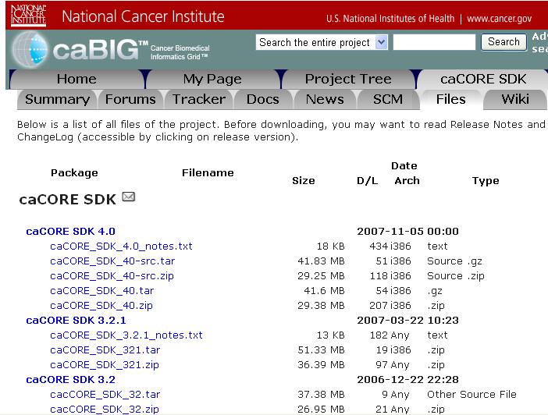
Download the caCORE SDK
https://gforge.nci.nih.gov/frs/?group_id=148

Slide 23
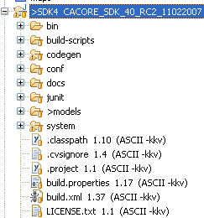
Download the caCORE SDK
Placeholder for configuration files
Placeholder for XMI File

Slide 24
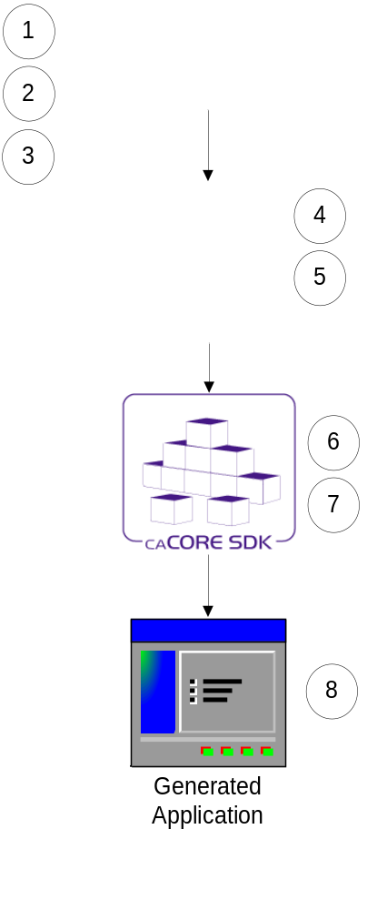
Running the Code Generator
Create Object Model (EA/ArgoUML)
Create Data Model (EA/ArgoUML)
Export the model in XMI format
Perform Object to Table mapping (caAdapter)
Perform Attribute to Column mapping (caAdapter)
Configure the code generator
Run the code generator
Running the generated system
Assumption: Database is already configured and tables are populated with data
Note: Steps 4 & 5 can be performed in EA/ArgoUML without using caAdapter.

Slide 25
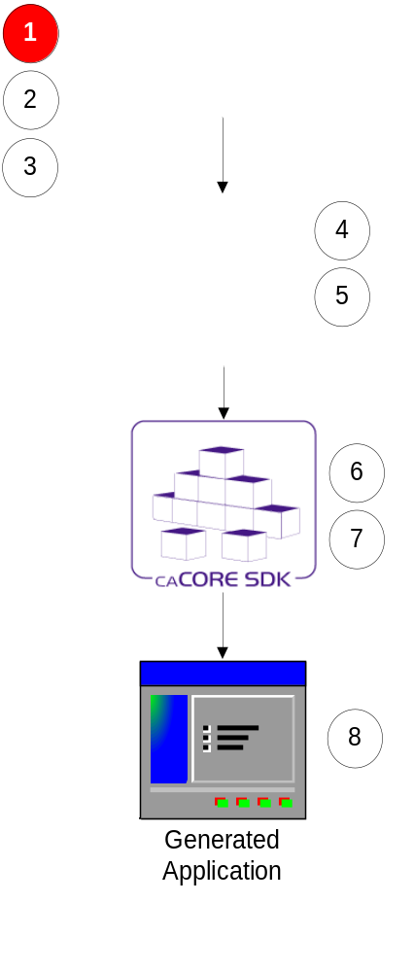
Step 1:
Creating Object Model (Enterprise Architect)
Define classes and its attributes
Define associations between classes
Note: Always follow naming conventions mentioned in the programmer’s guide

Slide 26
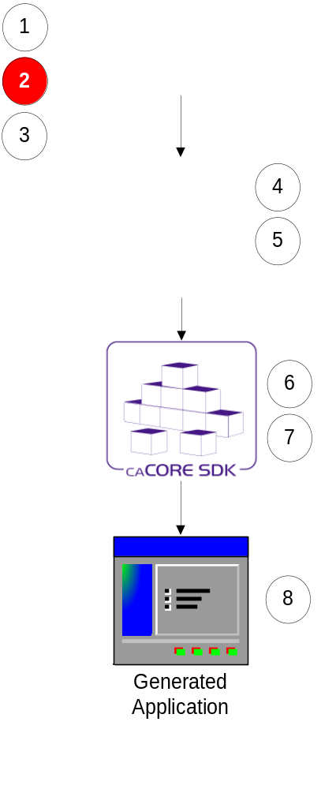
Step 2:
Creating Data Model (Enterprise Architect)
Define tables and its columns
Define primary key and foreign key constraints

Slide 27
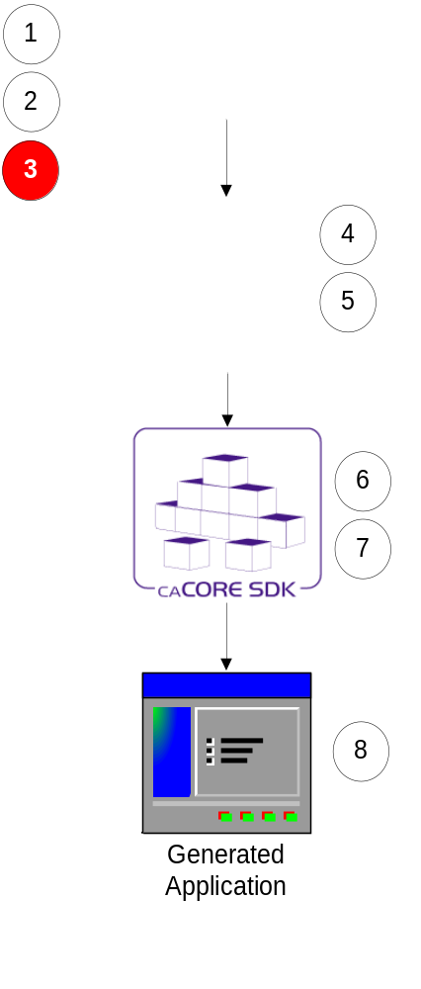
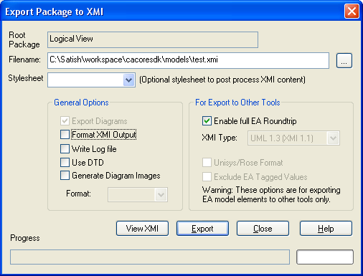
Step 3:
Export the UML Model
Export the UML model in XMI format

Slide 28
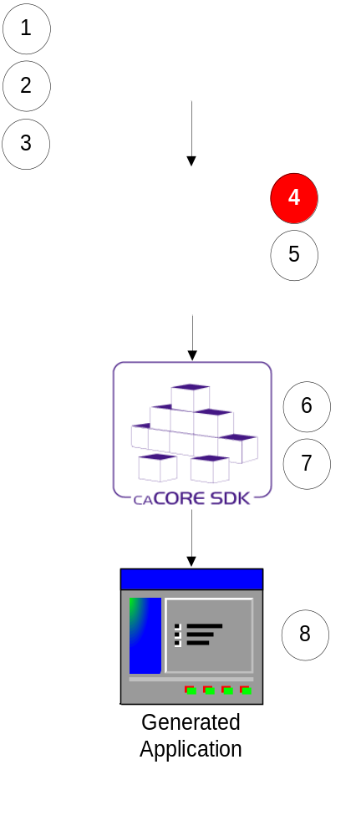
Step 4: Perform Class to Table Mapping
(caAdapter or Enterprise Architect)
Create Dependency link between a Class and a Table
i.e. drag class and drop it on table

Slide 29
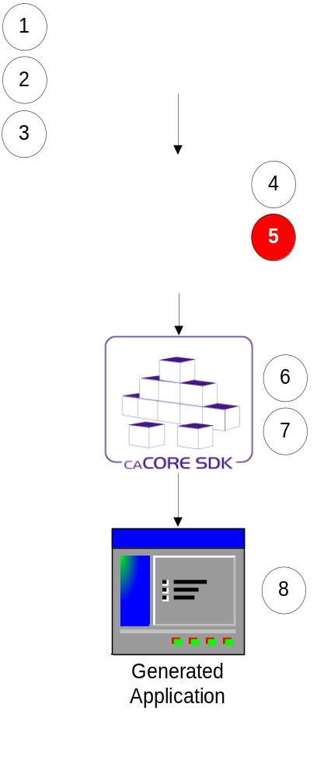
Step 5: Perform Attribute to Column Mapping
(caAdapter or Enterprise Architect)
Create link between a class attribute and table column using a Tag Value
i.e. drag attribute and drop it on column and drag association and drop it on foreign key column

Slide 30
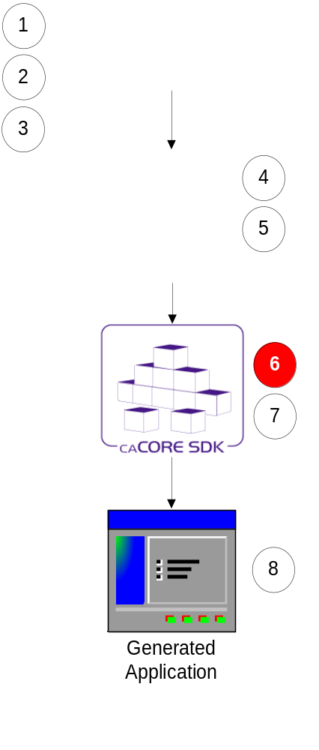
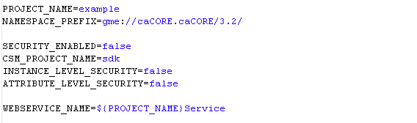
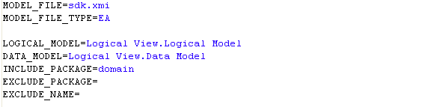
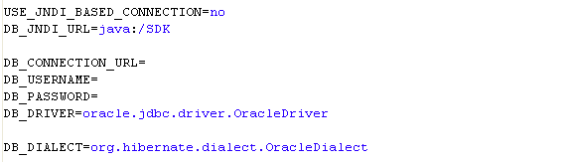
Step 6:
Configure Code Generator
Configuration defined in deploy.properties
Security Settings
Model Settings
Database Settings

Slide 31
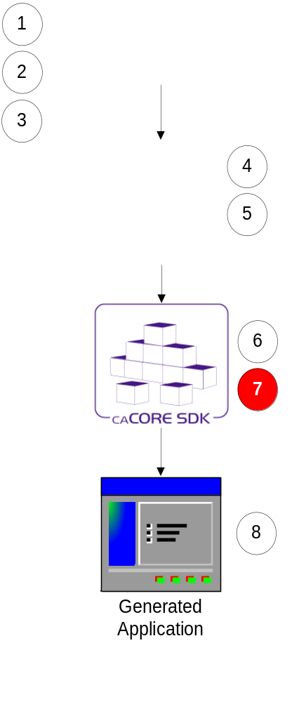
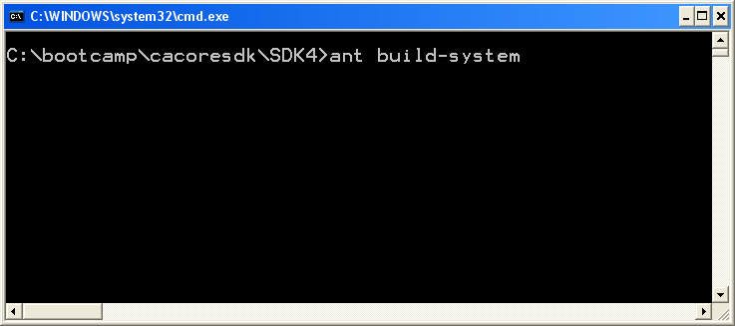
Step 7:
Run Code Generator
Put exported XMI file in caCORE SDK’s models directory
Go to command window
Execute build-system target

Slide 32
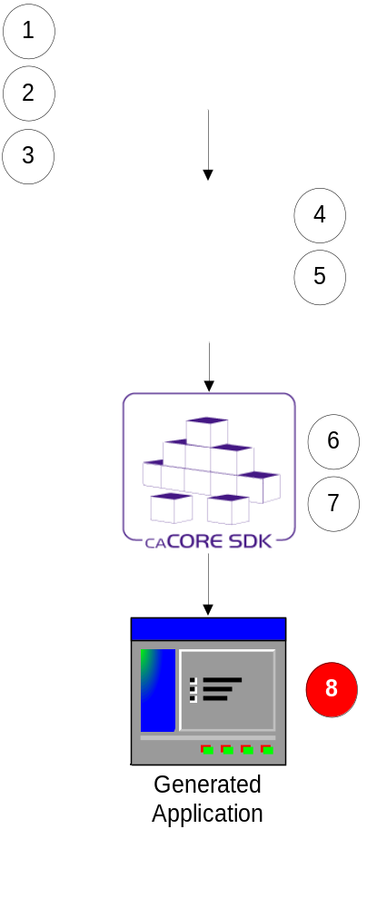
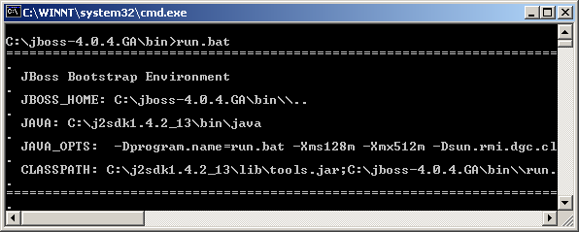
Step 8:
Running Generated System
Copy generated application to the server
Start the application server

Slide 33
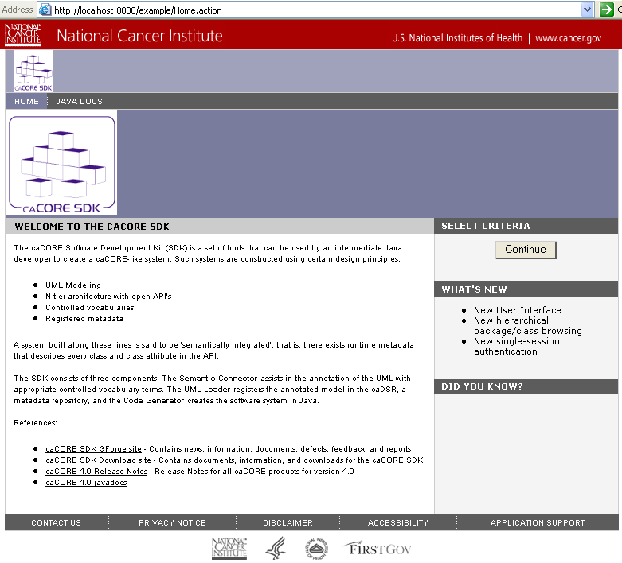
SDK Generated System – HTTP Interface

Slide 34
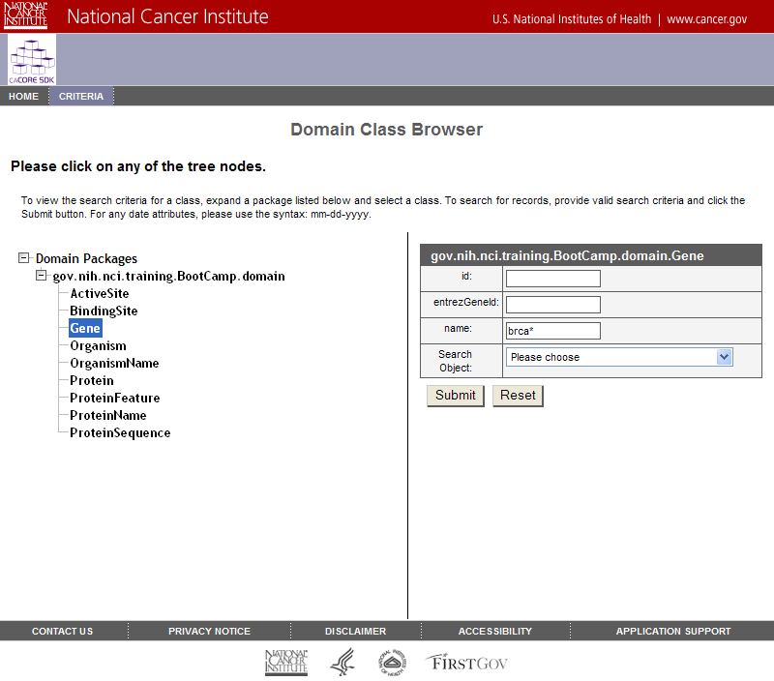
SDK Generated System – HTTP Interface

Slide 35
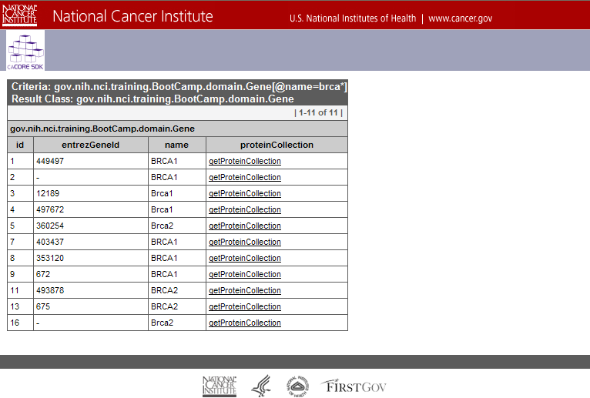
SDK Generated System – HTTP Interface

Slide 36
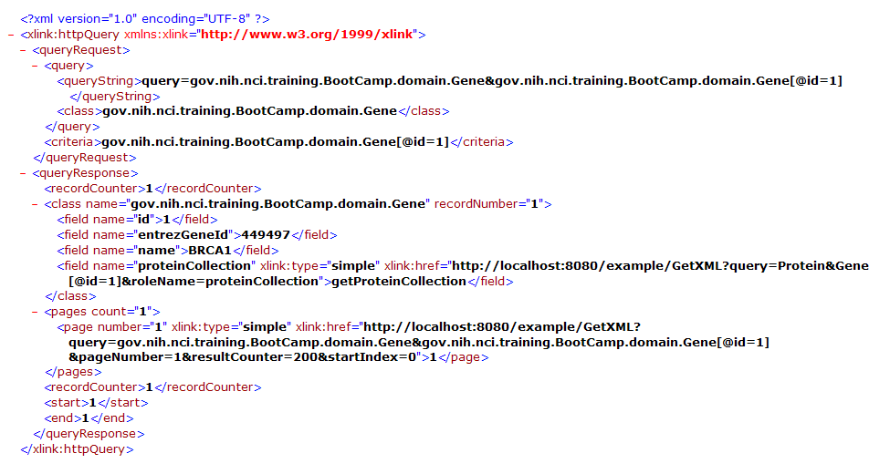
SDK Generated System – XML Interface

Slide 37
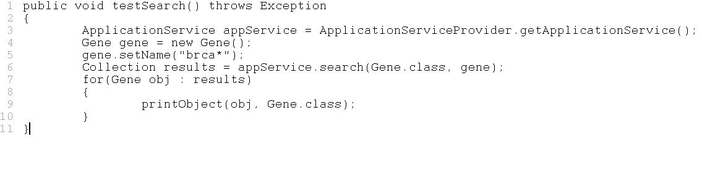
SDK Generated System – Java API

Slide 38
Finished Product
A simple system which allows you to share your data from relational database with the community in secured manner

Slide 39
Demonstration (Example Model)
Open command window
Start → Run → cmd
Go to SDK’s home directory
cd c:\bootcamp\cacoresdk\SDK4
Run code generator
ant build-system
Deploy generated system
cd output\example\package\webapp\
copy example.war c:\bootcamp\cacoresdk\jboss\server\default\deploy
Start application server
c:\bootcamp\cacoresdk\jboss\bin\run.bat
Test user interface
http://localhost:8080/example
Test Java API client
cd c:\cacoresdk\SDK4\output\example\package\remote-client
ant run

Slide 40
Questions ???
SDK Users Mailing List
cacore_sdk_users-L@list.nih.gov
http://ncicb.nci.nih.gov/NCICB/infrastructure/cacoresdk

